Slide 1
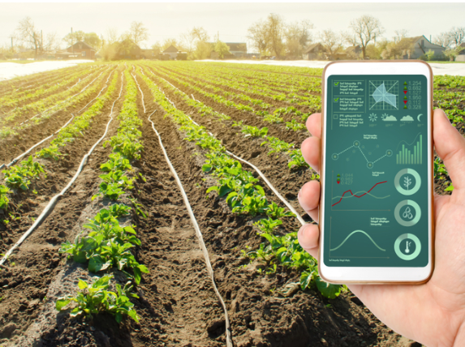
Crop Production Analysis in India
Mohammad Soyal

Slide 2
Introduction
"Agriculture plays a vital role in India's economy, significantly contributing to both GDP and employment.
This project focuses on visualizing crop production data and identifying key indicators and metrics that influence crop yields.
The dataset covers multiple years and includes detailed information on crop production across various states and districts in India."

Slide 3
Data Cleaning and Transformation
“ Missing values in the Production column were filled using the median to ensure data completeness.
I carefully ensured that each column had the appropriate data type, converting years to integers and production values to floats where necessary.
To maintain the integrity of the dataset, I identified and removed duplicate rows, ensuring consistency across all data points.
I then aggregated the data to obtain the total production figures, breaking it down by year, state, and crop, which provided a clearer view of production trends over time and regions.
Additionally, I created new features, such as production per area, to offer more detailed insights into the factors influencing crop yields."

Slide 4
Dataset Overview
Columns :
State_Name: Name of the state.
District_Name: Name of the district.
Crop_Year : Year of crop data.
Season: Season (e.g., Kharif, Rabi).
Crop: Type of crop.
Area: Area cultivated (in hectares).
Production: Crop production (in tons).

Slide 5
Regional Sales Distribution
No.Of District :646
No.Of.States :33
Key Insights:
Highest Crop Year : Whole Year
Top 3 High Production : Kerala , Andhra Pradesh and Tamil Nadu.

Slide 6
Item Type Sales Breakdown
Top Item Types:
Autumn : 64.43%
Top 3 : Bihar , Odisha and West Bengal
Kharif : 4.03bn %
Top 3 : Uttar Pradesh , Maharastra and Punjab
Rabi : 2.05bn %
Top 3 : Uttar Pradesh , Punjab and Madhya Pradesh
Summer : 170.68M %
Top 3 : West Bengal , Karanataka and Assam
Whole Year :134.43bn
Top 3 : Kerala , Andhra Pradesh and Tamil Nadu

Slide 7
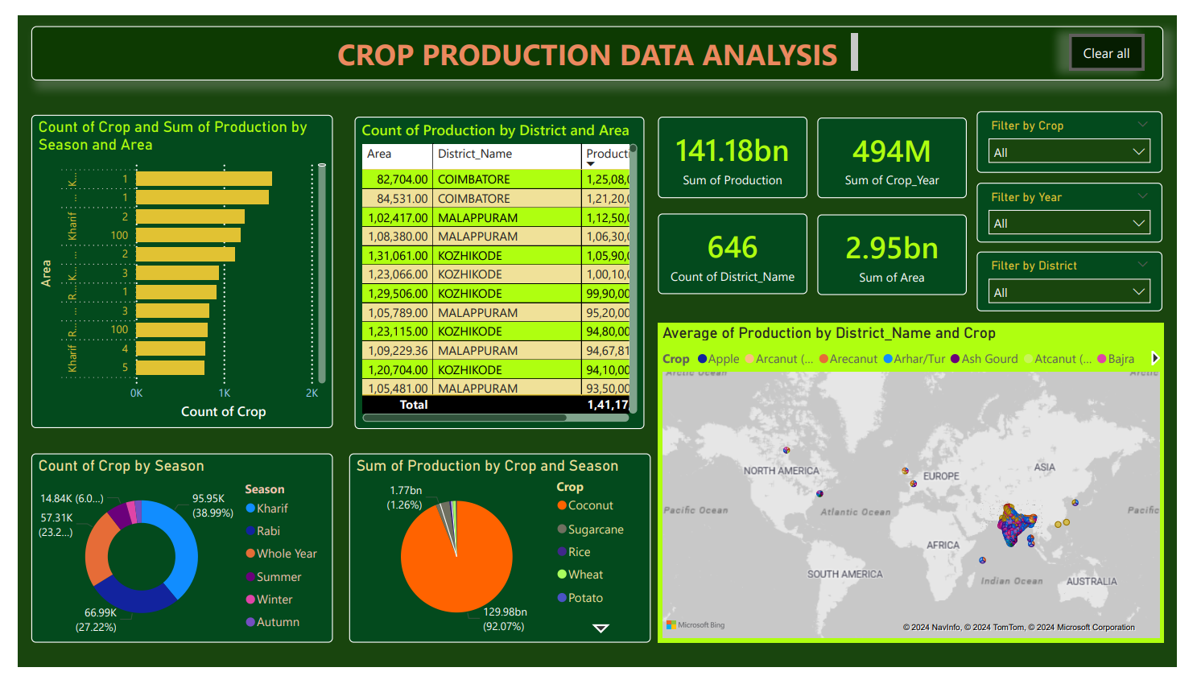

Slide 8
Conclusion
Data Cleaning:
Handled Missing Values: Filled missing values in the Production column with the median.
Data Type Verification: Ensured appropriate data types for each column.
Removed Duplicates: Identified and removed duplicate rows.
Data Transformation:
Aggregation: Aggregated data to get total production by year, state, and crop.
Feature Engineering: Created additional features like production per area for deeper insights.
Visualization in Power BI:
Line Chart: Displayed crop production trends over the years.
Bar Chart: Compared crop production across different states.
Pie Chart: Showed the proportion of different crops produced.
Map Visualization: Displayed crop production by district.

Slide 9

Thank You
Mohammad Soyal

